Slide 1

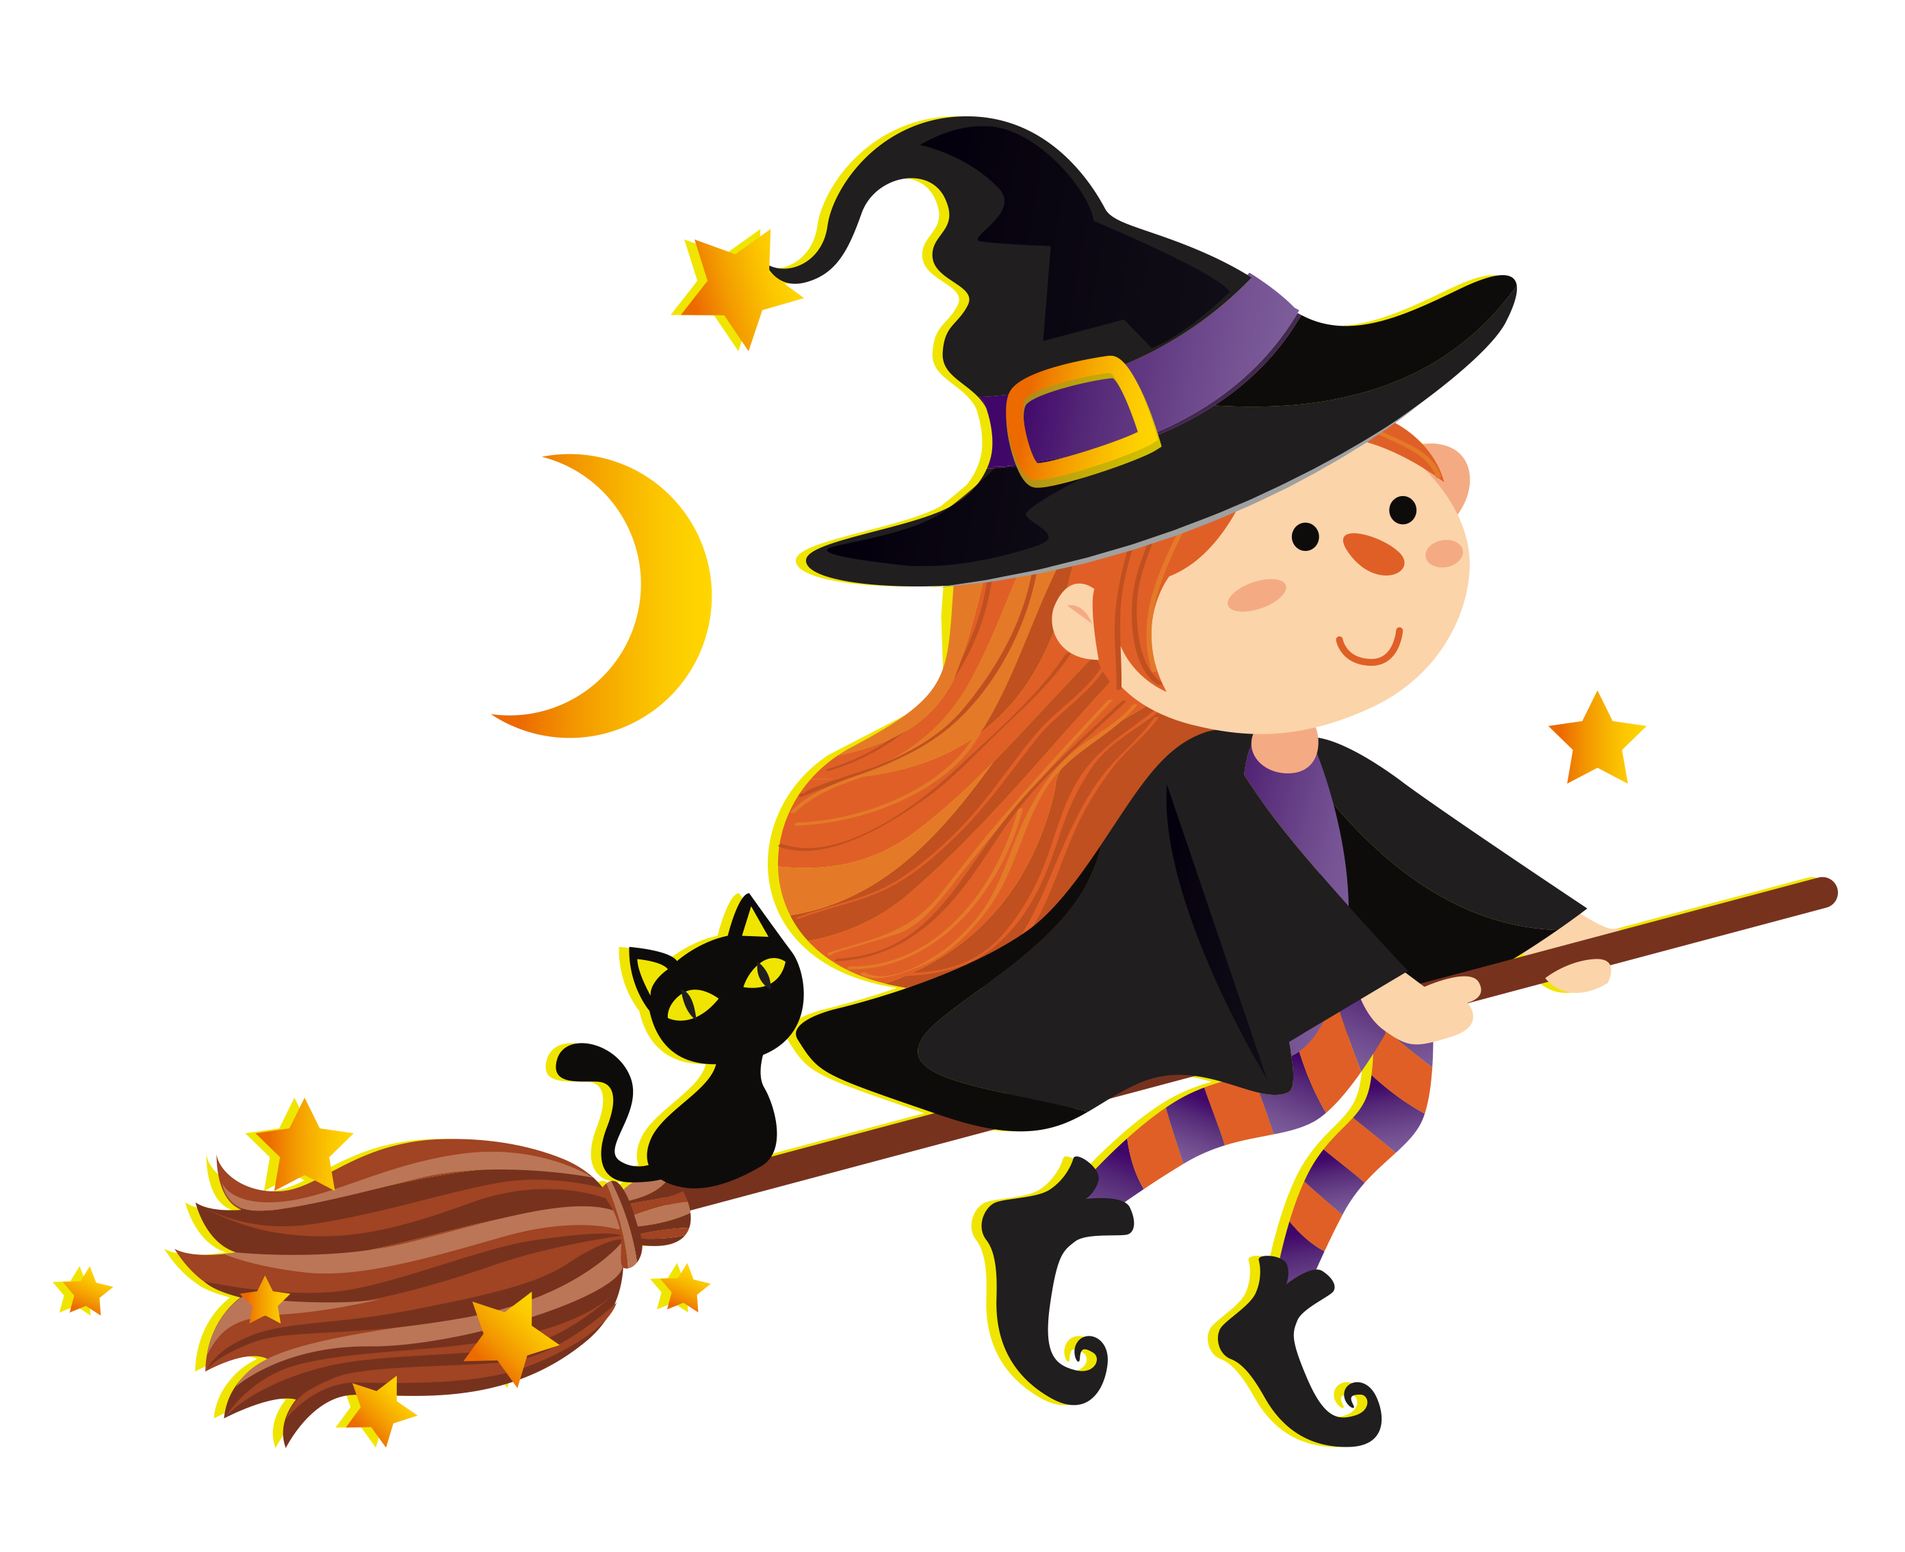
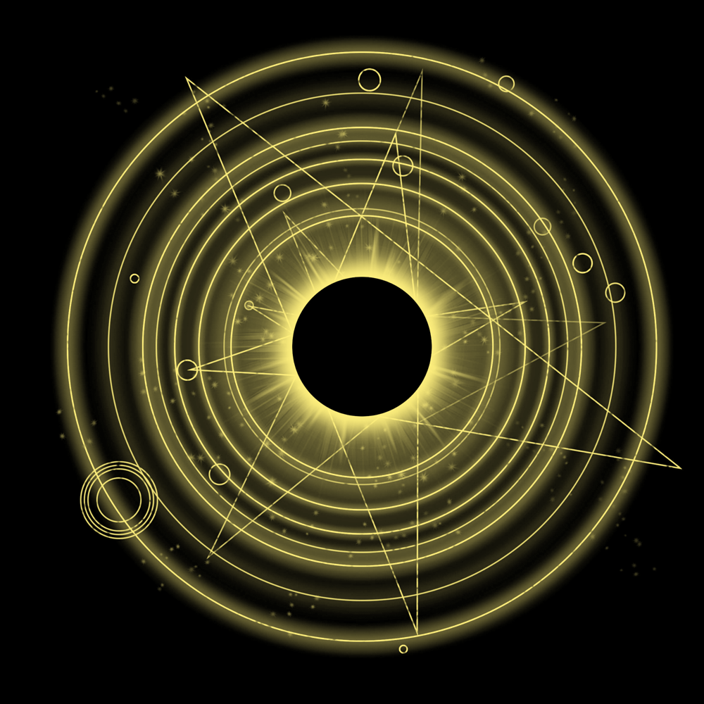
Taro Master Report

Slide 2
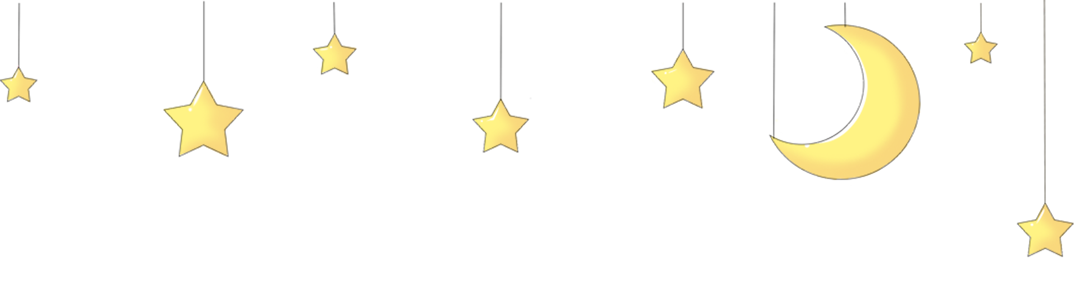

Overview
Of course! Let's see what the cards have in store for you. The Fool card suggests new beginnings, a sense of adventure, and stepping into the unknown with optimism and trust in the universe. It encourages you to take a leap of faith and embrace the journey ahead with a light heart and an open mind. The Tower card signifies sudden change, upheaval, and the breaking down of old structures to make way for something new and transformative. It may indicate a necessary upheaval to release you from stagnant patterns or beliefs that are holding you back. The Star card represents hope, inspiration, and spiritual guidance. It symbolizes a sense of renewal and healing after a period of turmoil or uncertainty, reminding you to stay connected to your inner guidance and trust in the universe's plan for you. Overall, these cards suggest that you are on the brink of a major transformation and that while it may initially feel disruptive or chaotic, it is ultimately leading you towards a brighter future filled with hope, renewal, and new beginnings. Embrace the changes ahead with an open heart and a willingness to let go of the past to make room for the blessings that await you. Remember to trust in the universe's guidance and believe in the magic of new beginnings.

Slide 3

Love
Ah, the cards have spoken! Let's see what the future holds in terms of your love life for the next one to three months. The first card drawn is The Lovers, which indicates that you may experience a deep connection with someone special in the upcoming months. This could be a new romantic relationship or an existing partnership reaching a new level of intimacy and understanding. Love is definitely in the air! Next, we have The Knight of Cups, suggesting that a charming and romantic individual may enter your life soon. This person could sweep you off your feet with their romantic gestures and emotional depth. Be open to this new connection and allow yourself to be vulnerable in love. Finally, The Four of Wands appears, symbolizing celebration and harmony in your love life. This card signifies a period of joy, happiness, and stability in your romantic relationships. You may find yourself feeling content and secure in your partnerships, with a sense of unity and shared goals. Overall, the cards indicate a positive and fulfilling period ahead in terms of love and relationships. Keep your heart open to new possibilities and be ready to embrace the love and happiness that are coming your way. Enjoy the journey and trust in the magic of the universe to bring you the love you deserve. Good luck on your romantic adventures, and may love always find its way to your heart!

Slide 4

Career
Of course, let's see what the cards have in store for your career in the next one to three months based on the cards you drew. The first card you pulled is the Ace of Pentacles, indicating new beginnings and opportunities in your career. This card suggests that you may come across a promising job opportunity or a chance to improve your financial situation in the near future. It's a good sign that your hard work will pay off and bring tangible rewards. The second card is the Queen of Wands, highlighting your creativity, passion, and leadership skills. This card suggests that you will approach your work with confidence and enthusiasm, making a strong impression on others. You may find yourself taking on more responsibilities or leading a project to success during this period. The final card you drew is the Eight of Pentacles, representing diligence, skill development, and craftsmanship. This card indicates that your focus on honing your craft and mastering your skills will bring you closer to your long-term career goals. It's a reminder to stay dedicated and committed to your work to achieve success. Overall, these cards paint a picture of a period filled with exciting opportunities, creativity, and hard work paying off in your career. Keep your eyes open for new beginnings, trust in your abilities, and continue to put in the effort to see positive results in the next one to three months. Good luck!

Slide 5

Finance
Ah, the cards have spoken! Let's see what the future holds for you in terms of your finances for the next one to three months. The first card, the Five of Pentacles, suggests that you may experience some financial setbacks or challenges in the near future. This could be a warning to be cautious with your spending and to avoid making any major financial decisions without careful consideration. On the bright side, the second card, the Ace of Pentacles, indicates that there is potential for a new financial opportunity or source of income to come your way. This could be a sign to stay open to new possibilities and to seize any chances for financial growth that may present themselves. Finally, the third card, the Ten of Pentacles, brings good news for your long-term financial stability. This card signifies abundance, wealth, and overall financial security. It suggests that your efforts in managing your finances will pay off in the end, leading to a prosperous outcome. Overall, the cards suggest that while you may face some challenges in the short term, there is also great potential for financial growth and stability in the future. By staying mindful of your spending and remaining open to new opportunities, you can navigate any financial hurdles that come your way and ultimately achieve success in your financial endeavors.

